Slide 1
Ready for Round Tw0?
Shared Christian Praxis and Prayer
Classroom Management and Youth Ministry

Slide 2
Send a tweet
140 characters
About you as a catechist
#Lifelonglearner
#Iloveteens

Slide 3
Directions
You have 10 minutes to:
Using your scripture: come up with a short summary (1 minute in length) – As skit, as poem, as meme, as sound-byte, as rap, as presentation (poster, picture, etc.)
A Portrait of the relationship between the person who meets Jesus – and Jesus’ response.
Notes:
Talking Points
Ask participants to open their book and follow along. Pg. 9

Slide 4
Woman caught in adultery – (John 8:1-11)
Woman at the well – (John 4:5-42)
Zacchaeus-(Luke 19:1-10)
Jesus blesses the little children (Matt 19:13-15;Luke 18:15-17;Mark 10:13-16)
Prodigal Son (Luke 15:11-32)
Notes:
Talking Points
Each group gets one scripture.

Slide 5
Let’s use what we have created to pray
Opening:
Jesus takes us where we are and loves us completely and unconditionally then moves us into reconciliation with himself and others
Notes:
Talking Points
In the name of the Father, the son and the Holy Spirit.
Now each group shares their scripture summary

Slide 6
Prayer-cont.
Heavenly Father, Help us to
Accept our teens where they are
Love them completely and unconditionally
Move them into a closer relationship with Jesus – so that they can be reconciled with Him and with the world around them.
Help us to remember that we are just echo’s of the faith – it does not begin or end with us –
as Paul reminds us…

Slide 7
Apollos and I are merely servants who helped you to have faith. It was the Lord who made it all happen.
I planted the seeds, Apollos watered them, but God made them sprout and grow. What matters isn't those who planted or watered, but God who made the plants grow.
- 1 Corinthians 3:4-7
Notes:
Talking Points
And the Church says: AMEN!!!!
Knowing Their Story Accepting the Whole Package of Young People
Value young people as a gift to be shared not a problem to be solved
young people don’t need to know everything before they are out of Confirmation process –
Why? Because becoming a disciple is a LIFE-LONG PROCESS

Slide 8
Let’s follow Jesus’ example
Jesus was about Relationships
Jesus loves us where we are at….
Jesus didn’t use a cookie cutter approach to conversion of people
Jesus’ call was not limited to the learned Rabbi’s or leaders of the faith
Notes:
(relate back to opening prayer)
young people are NOT at the same level in any area – so…..we need to love them where they are at.
– we need to use different learning styles to reach youth via their different gifts
– He called and trusted uneducated fishermen and sinners to continue his mission
* Reference to stages of development and C-Level

Slide 9
What is necessary for Catechetical Sessions?
Notes:
Before beginning to plan the session, Catechist should “begin with the end in mind” and jot down the main idea of the session as well as some Learning objectives the candidates
Ask the learners to shout our answers.

Slide 10
Catechesi Tradendae
The name of catechesis was given to the whole of the efforts within the Church to make disciples, to help people to believe that Jesus is the Son of God, so that believing they might have life in His name, and to educate and instruct them in this life and thus build up the Body of Christ. (no.1)
Notes:
This document written by John Paul II in 1979
Catechesis in our time
So our goal for all things is to make disciples. - So how do we do that?

Slide 11
Shared Christian Praxis
Shared Christian Praxis is a process of thinking about life and where God is actively present, learning from it, reflecting on it, and letting it motivate our action.
It helps us to answer the question “ So What ? ” – What does this mean for me as a young person of faith? What difference will this church teaching make and how will it shape or impact my life?

Slide 12
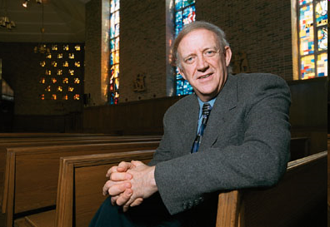
Tom Groome
Started as a high school teacher
Teaches at Boston College
Father of the
Shared Christian Praxis
Notes:
Shared Christian Praxis is the founder of this pragmatic approach. He felt that shared Christian Praxis was the necessary and good approach to Religious Education.

Slide 13
Freedom Writers
http://www.youtube.com/watch?v=PahVp7p3XHg
Notes:
In this movie, Hilary Swanks character is a first year high school teacher in a tough school in Los Angeles, She is teaching English
SHOW CLIP
Thomas Groome suggests that all learning happens when we meet a person where they are. In this clip – that’s what Hilary does. She seeks a creative way to meet the young people where they are at. Seeking to engage through an activity.

Slide 14
Taking Life to Faith and Faith to Life
Notes:
When using Shared Christian Praxis – how do we take life to faith and faith to life?
The process should be able to focus people’s reflections on their experience of life in Jesus.
The Shared Christian Praxis approach is based on the assumption that God is everywhere. He is present and always has been present in our being.

Slide 15
Notes:
The goal can not be cognitive – the goal should not be information.
Ministry is not information – it’s transformation… how are we transformed by what we have learned and experienced?
How are we to become missionary disciples?

Slide 16
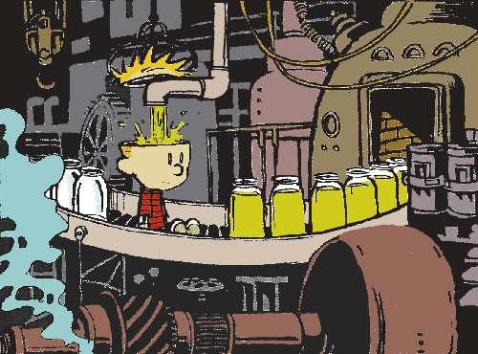
Religious Education should be more than a cognitive approach
Notes:
Not information dump - Transformation

Slide 17
Shared Christian Praxis
Notes:
So the shared Christian praxis is a template for success. (Page 93)
First we look at the Session Goal – What is the main idea for the session
Then we discuss the elements of Trusting, Believing, Doing - at the end of the session – what do we hope the candidates understand about the Christian Faith?
Then we look at the activities, experiences, and reflections that help to achieve these goals

Slide 18
Our Goal for today
By the end of our session participants will understand the Shared Christian Praxis and how to use it when planning a session.
Notes:
So if putting this in practice for today….. This would be our goal

Slide 19
Objectives for today
Trusting: By the end of our session the participants will have the skills to plan Sessions that not only touch the mind but also touch the heart.
Believing: By the end of our session the participants will have explored the Catechist's call to holiness.
Doing: By the end of our session the participants will have tools to use the Shared Christian Praxis and an opportunity to learn from one another.
Notes:
What do we want our participants/student to trust, know that we are in a relationship with God.
How are we going to help our participants/student to believe
And how are we going to remind them that we are pilgrim people seeking to build the kingdom, and therefore we are called to action.

Slide 20
Shared Christian Praxis
Main Idea of Session: The goal or mission of the session
Learning Objectives
Trusting:
Believing
Doing
Notes:
This is what your DRE or Confirmation coordinator gives you… It’s the topic or the theme of the session (7 Gifts of the Holy Spirit, Forgiveness, etc. )

Slide 21
Shared Christian Praxis
Main Idea of Session: Learning Objectives
Trusting: Measurable objective about trusting-Our faith is based on a relationship between God and Us. In this session how will I express that, given my topic?
Believing
Doing

Slide 22
Shared Christian Praxis
Main Idea of Session: Learning Objectives
Trusting:
Believing: Measurable objective about belief. Our faith asks us to believe doctrine, faith themes, etc. What belief themes will be taught in the session? How are you going to enable children/teens/adults to believe this truth?
Doing

Slide 23
Shared Christian Praxis
Main Idea of Session: Learning Objectives
Trusting:
Believing
Doing: Measurable objective about our response or action. -Our faith is based on works. What are you asking the children/teens/adults to do?

Slide 24
Shared Christian Praxis
The Session Plan:
Focusing Activity
Naming-Experiencing Life
Reflecting Together
Discovering the Christian Story
Integrating-Owning the Faith
Responding in Faith
Notes:
These steps move from one to the other.
I have yet another clip, Hoping it will focus on our need to be prepared and varied.

Slide 25
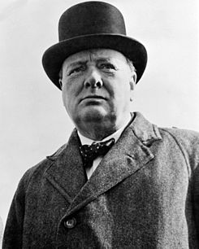
If you want me to speak for an hour --give me a moment’s notice;
If you want me to speak for half an hour, -- give me a day’s notice;
If you want me to speak for five minutes --give me a week.
Winston Churchill
Notes:
I say this because at times we sometimes think,
Oh I’ve got this, but really good catechetical leadership takes time.
Remember when you were in HS or college they said for every hour in the class your you need to spend that much time or more in prep and homework
Yep, the students and participants are expecting a well prepared session.
Planning a session takes time – you can’t wing it.

Slide 26
Shared Christian Praxis
The Session Plan: Outline
Focusing Activity
Naming-Experiencing Life
Reflecting Together
Discovering the Christian Story
Integrating-Owning the Faith
Responding in Faith

Slide 27
Shared Christian Praxis
The Session Plan
Focusing Activity: The activity, movie clip, game, song, skit, poster, or prayer that teases the topic. It sets the stage. It makes the transition from our real life and this session
Naming-Experiencing Life
Reflecting Together
Discovering the Christian Story
Integrating-Owning the Faith
Responding in Faith
Notes:
What is the hook that draws them into the topic? Is this a video? Icebreaker? Community Builder? Story? Skit?
It focuses the group and sets the stage for what is to come

Slide 28
Shared Christian Praxis
The Session Plan
Focusing Activity:
Experiencing Life: How does this topic fit into their life? What do they know about the topic? How does it fit into their way of thinking?
Reflecting Together
Discovering the Christian Story
Integrating-Owning the Faith
Responding in Faith
Notes:
This part helps you to introduce the topic, concept, or learning experience. How is the topic of concept present in their own life experience? It invites them to express their experience, as well as the experience of their family, community, and ethnic culture.
Learners are encouraged to express what they already know about the topic or concept, how they feel about it, how they understand it, how they now live it, or what they believe about it.
Depending on the topic or concept, learners may need to participate in an activity to help them discover their own life experience. The learning design will need to
incorporate this initial experience.
It can be a movie clip, and ice breaker, an exercise. It is often fun. The trick is to engage the students.
Guided meditations, stories, question and answers are good techniques for helping the young people to launch their thinking that this topic is important to THEIR life.

Slide 29
Shared Christian Praxis
The Session Plan
Focusing Activity
Naming-Experiencing Life
Reflecting Together: The activity, which will help the participants explain their experience of this topic. Sometime they have no idea how—but help them to see the topic with new eyes.
Discovering the Christian Story
Integrating-Owning the Faith
Responding in Faith
Notes:
How will you engage then in critically reflecting on their present action?
The second movement in the learning process allows the learners to reflect together on what they have expressed in the first movement about their own experience. This will sometimes be intuitive as well as analytical. Movement Two engages reason, memory, and imagination. This is often done by sharing an actual story of their experience or an action they have taken. Learners are invited to reflect critically on the meaning of their own experience, share the consequences of their present experience, and make implications for the future.

Slide 30
Shared Christian Praxis
The Session Plan
Focusing Activity
Naming-Experiencing Life
Reflecting Together:
Discovering the Christian Story: The teaching part. Tell, witness, imaginatively present the church’s teaching on the topic.
Integrating-Owning the Faith
Responding in Faith
Notes:
This is the teaching moment… what does the church teach? Use scripture, quotes, etc.
Some call this the meat and potatoes part of the session, but I caution you
I enjoy the main course of a meal but do not forget the entrée and the dessert, and sometimes you need to eat your vegies.
The third movement in the learning process presents the faith story of the Catholic community in response to the topic or concept of the learning experience. The faith story is the whole faith identity of the Catholic community. Here learners explore the story of faith that comes to us from Scripture, Tradition, the teachings of the Church, and the faith-life of Christian people throughout the ages and in our present time.

Slide 31
Shared Christian Praxis
The Session Plan
Focusing Activity
Experiencing Life
Reflecting Together
Discovering the Christian Story
Integrating-Owning the Faith: The role play, discussion, activity which helps the students to believe this topic is also a part of their faith journey.
Responding in Faith
Notes:
The fourth movement in the learning process provides learners with an opportunity to correlate their experience and faith to Scripture and the Catholic faith tradition. The purpose of the fourth movement is to enable the learners to integrate the wisdom of the Catholic faith tradition back into their own lives and to appropriate its meaning in their lives—to make it their own.
What connection is there between their story and that of the Church?

Slide 32
Shared Christian Praxis
The Session Plan
Focusing Activity
Naming-Experiencing Life
Reflecting Together
Discovering the Christian Story
Integrating-Owning the Faith
Responding in Faith: In light of the learning experience, how will participants be challenged to decide what action to take (socially, personally, interpersonally) What is their response? How will the participant live differently?
Notes:
The fifth movement in the learning process is designed to help the learners translate their learning into a lived faith response. Learners can be engaged in developing specific plans for
the coming weeks, in individual or group action projects which involve them in living their faith (in the faith community, school, family, community), in prayer experiences which
celebrate their responses, and in journaling activities where they can reflect on how they are living their faith.

Slide 33
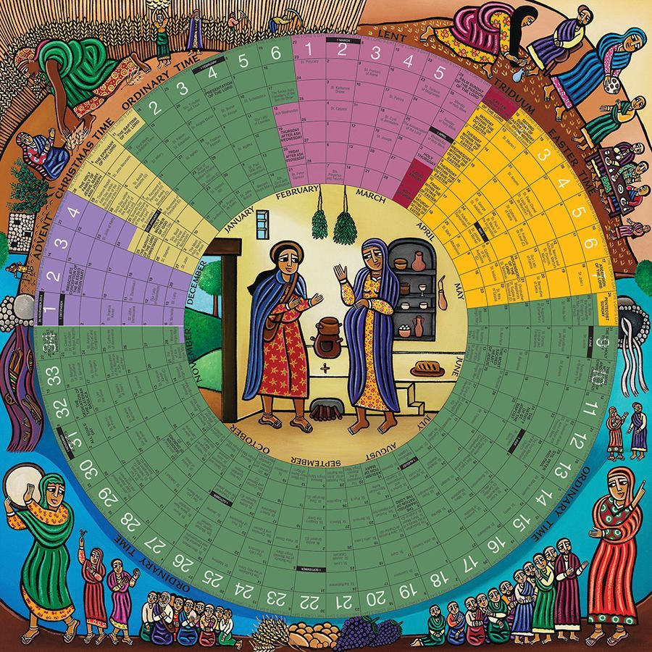
Sample Shared Christian Praxis
Main Idea of Session:
To share an overview of the Liturgical Calendar of our Church
Learning Objectives
Trusting:
Believing
Doing

Slide 34
Sample Shared Christian Praxis
Main Idea of Session: Students will understand the ebb and flow of the liturgical year.
Learning Objectives
Trusting:
Believing
Doing

Slide 35
Main Idea of Session: Learning Objectives
Trusting: By the end of the session students will be introduced to the ebb and flow of the major season of our liturgical calendar
Believing
Doing

Slide 36
Main Idea of Session: Learning Objectives
Trusting:
Believing: By the end of the session students will believe that the authors of the liturgical calendar are telling the story of Jesus over a one year period.
Doing

Slide 37
Main Idea of Session: Learning Objectives
Trusting:
Believing
Doing: By the end of the session students will be able to place major liturgical seasons and events on a calendar. Be acquainted with Liturgical Color and season, and see how the liturgical has a rhythm much like their lives.

Slide 38
Shared Christian Praxis
The Session Plan
Focusing Activity: Try to put the liturgical year in order—An icebreaker (R: 5X7 cards)
Naming--Experiencing Life
Reflecting Together
Discovering the Christian Story & Vision
Integrating Owning the Faith
Responding in Faith

Slide 39
Shared Christian Praxis
The Session Plan
Focusing Activity:
Naming--Experiencing Life: Where does your birthday fit into the year? (R. Liturgical calendar)
Reflecting Together
Discovering the Christian Story & Vision
Integrating Owning the Faith
Responding in Faith

Slide 40
Shared Christian Praxis
The Session Plan
Focusing Activity
Naming--Experiencing Life
Reflecting Together: Each group becomes a season. Participants must come up with the color, a story from the Bible that fits into this season, a liturgical song, a popular song, movie and story that is like this liturgical theme.
Discovering the Christian Story & Vision
Integrating Owning the Faith
Responding in Faith

Slide 41
Shared Christian Praxis
The Session Plan
Focusing Activity
Naming Experiencing Life
Reflecting Together:
Discovering the Christian Story & Vision: Teach about the Liturgical year.
Integrating Owning the Faith
Responding in Faith

Slide 42
Shared Christian Praxis
The Session Plan
Focusing Activity
Naiming Experiencing Life
Reflecting Together
Discovering the Christian Story & Vision
Integrating--Owning the Faith: Choose one story found in your liturgical season and write a homily.
Responding in Faith

Slide 43
Shared Christian Praxis
The Session Plan
Focusing Activity
Naming--Experiencing Life
Reflecting Together
Discovering the Christian Story & Vision
Integrating Owning the Faith
Responding in Faith: Using the current Liturgical season, plan a liturgically rich blessing for the end of the session. Write a prayer for a family member tied to the liturgical season.

Slide 44
Notes:
You’re done ready start go….
Perhaps one more look

Slide 45
Shared Christian Praxis
Questions

Slide 46
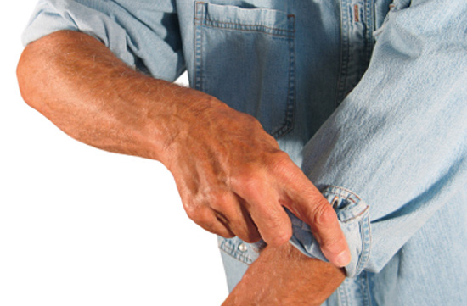
Ready to roll up your sleeves?
Notes:
Now we are going to do the shared Christian Praxis!

Slide 47
Your Turn
40 minutes
Pass out the Shared Christian Praxis worksheet
Choose a scribe
In short phrases transfer the ideas for the objectives and movements onto easel paper

Slide 48
Your Turn
Main Idea of the Session
Learning Objectives
Trusting, Believing, Doing
The Session Plan:
Focusing Activity
Experiencing Life
Reflecting Together
Discovering the faith story
Owning the Faith
Responding in Faith
Notes:
When they are giving their presentations—be sure to acknowledge the intelligences they are highlighting---
Create a tool for evaluation of the use of various intelligences

Slide 49
For your presentation
Write the subject of the topic
Write a one sentence objective (trusting, believing, or doing)
Write a one sentence describing what you’re going to do for each movement.
Highlight one of them, the one where there is a great deal of passion.
Write them out on an easel paper, and be wiling to present your lesson after lunch.
Notes:
When they are giving their presentations—be sure to acknowledge the intelligences they are highlighting---
Create a tool for evaluation of the use of various intelligences

Slide 50
For your presentation
Notes:
When they are giving their presentations—be sure to acknowledge the intelligences they are highlighting---
Create a tool for evaluation of the use of various intelligences
Themes….Justice, Service, Eucharist, Mercy, Morality, etc.

Slide 51
Do everything in 8 seconds

Slide 52
Gathering Environment
Notes:
To create a prayerful environment and helps to make our sessions more appealing and perhaps help in the prayerful reflections at prayer time
Page 102

Slide 53
What you need
Placemats or fabric squares
Bible
Candle/Matches or Candle with Batteries
A plant or flower
Some symbol from the lesson
Notes:
I like to use liturgical symbols and colors
I have a five placemats one green, white, red, purple and lavender.
I use flowing plants during Easter and Christmas, Green plants during Advent and Ordinary Time, and cactus during Lent
Most of the time I use candles. But in some settings, I use the battery powered ones
I always put my Bible out
And I think of symbols of the lesson, Talking about Jesus, I might put a Jesus Icon,
Talking about confirmation a symbol of the Holy Spirit of the seven gifts.

Slide 55
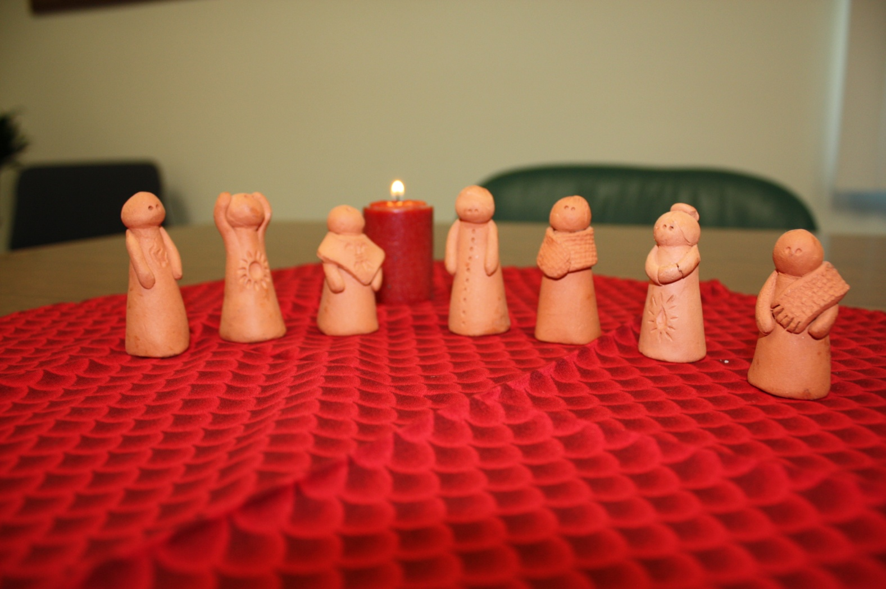

Slide 58
Set Up
What are the most important five minutes of the session? (this is a trick question)
Notes:
I always try to set up the holy space just before the teens come in because the most important five minutes are the five minutes before session. That is when a young person might want to come in early to speak to you. I like to be doing something, yet something not too challenging like writing on the chalk board, I can give attention to what they are saying.

Slide 59
Prayer Experiences
Notes:
Page. 103-105

Slide 60
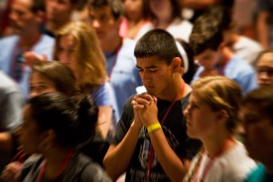
Framework of Gathered Prayer
Gather
Listen
Respond
Send Forth
Notes:
Sound a bit like the formula for our liturgies

Slide 61
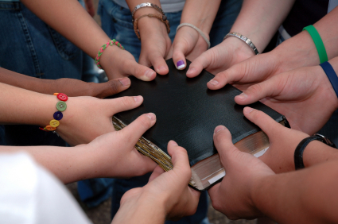
Gather
Awareness of being in the presence of God, and in the presence of the Body of Christ.
Notes:
Using the sign of the cross is always a good way to start. Having them realize that God dwells in them and in the others gathered is a wonderful truth

Slide 62
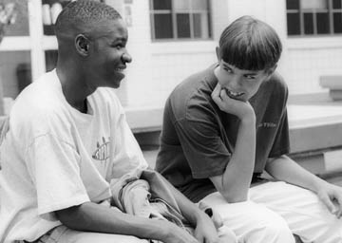
Listen
To the word of God
A story
A speaker
A lesson
Music
Notes:
Allowing all gathered to hear something and reflect on the words

Slide 63
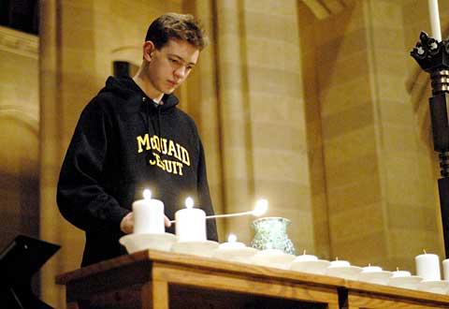
Respond
How are we to keep this alive
How are we changed by these words
How are we called to respond?
What are our prayers?
Notes:
It may be in prayer, in silence, in writing in sharing

Slide 64
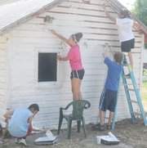
Send Forth
How are we renewed?
What has changed?
How might we live the message?
Notes:
A sign of peace may be appropriate here
Ending with the sign of the cross or a familiar prayer like the Our Father

Slide 65
16 things to Consider

Slide 66
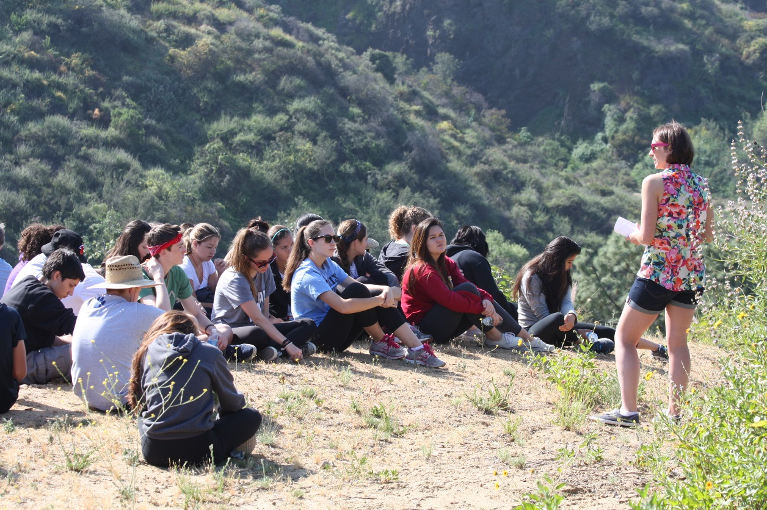
Spirit Scripture Music
The Holy Spirit guides all prayer. Prayer leaders do not perform, but offer themselves as a vehicle of the Spirit for those at prayer. Pray to the Holy Spirit to guide and inspire you.
Prayer services should always involve the Word of God so that participants can listen to God speaking to them.
Singing and instrumental music are not just frosting on the cake. They are essential ingredients in prayer services.

Slide 67
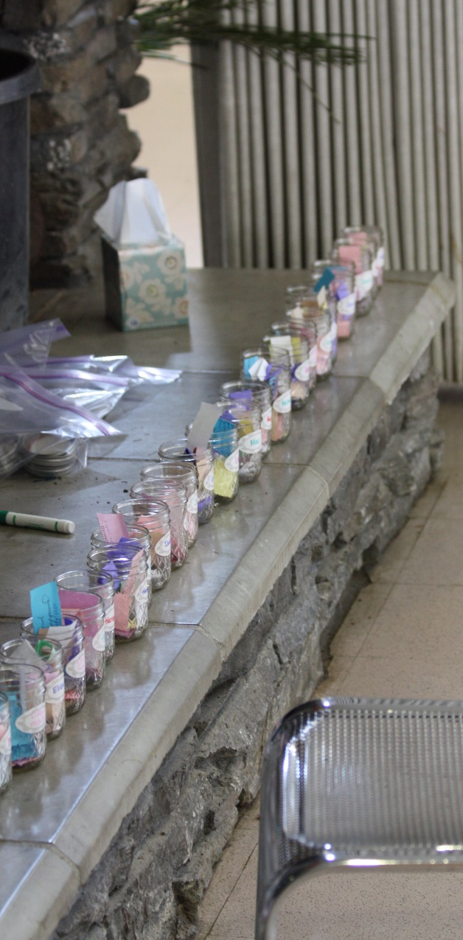
Environment Participation Non verbal
Introduce elements into the environment to create a greater awareness of the sacred. Consider candles (when appropriate), dimmed lights, enthroned Bible, cross, and objects from nature such as flowers, rocks, and shells.
Don’t think of what just you are doing during prayer. Ask yourself what the assembly is doing. Be sure to involve the assembly as a whole in the prayer, not just those taking the Leader or Reader roles.
Consider the elements of movement and gesture (procession, bowing, venerating the Bible, outstretching hands, laying on hands, blessing) and of symbols (water, oil) as well as of silence.

Slide 68
Environment Participation Non verbal
Introduce elements into the environment to create a greater awareness of the sacred. Consider candles (when appropriate), dimmed lights, enthroned Bible, cross, and objects from nature such as flowers, rocks, and shells.
Don’t think of what just you are doing during prayer. Ask yourself what the assembly is doing. Be sure to involve the assembly as a whole in the prayer, not just those taking the Leader or Reader roles.
Consider the elements of movement and gesture (procession, bowing, venerating the Bible, outstretching hands, laying on hands, blessing) and of symbols (water, oil) as well as of silence.

Slide 69
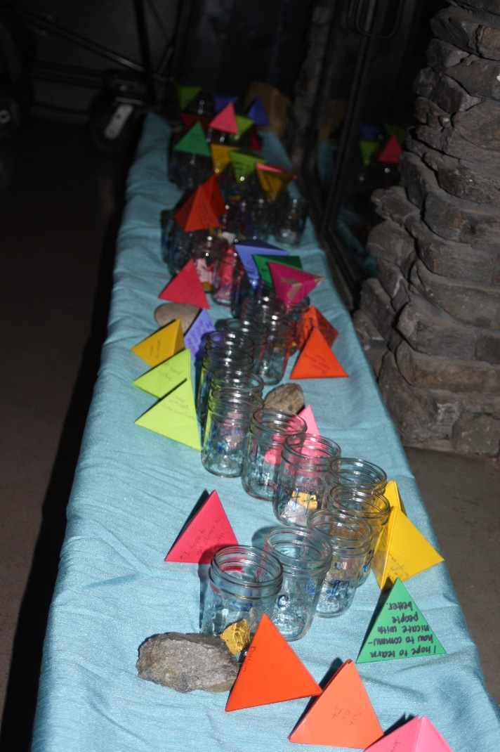
Verbal Elements Liturgical Season Know your audience
Follow and borrow from the prayer of the Church (Roman Missal, Liturgy of the Hours): introductory rites, psalm responses, antiphons, penitential acts, collects, intercessions, and blessings. These prayers are rich and evocative and therefore, powerful.
Pay special attention to the time of the liturgical year (Advent, Lent, feasts, solemnities) when selecting themes and prayers.
Be aware of the age level of your assembly and their faith development as well as their level of maturity.

Slide 70
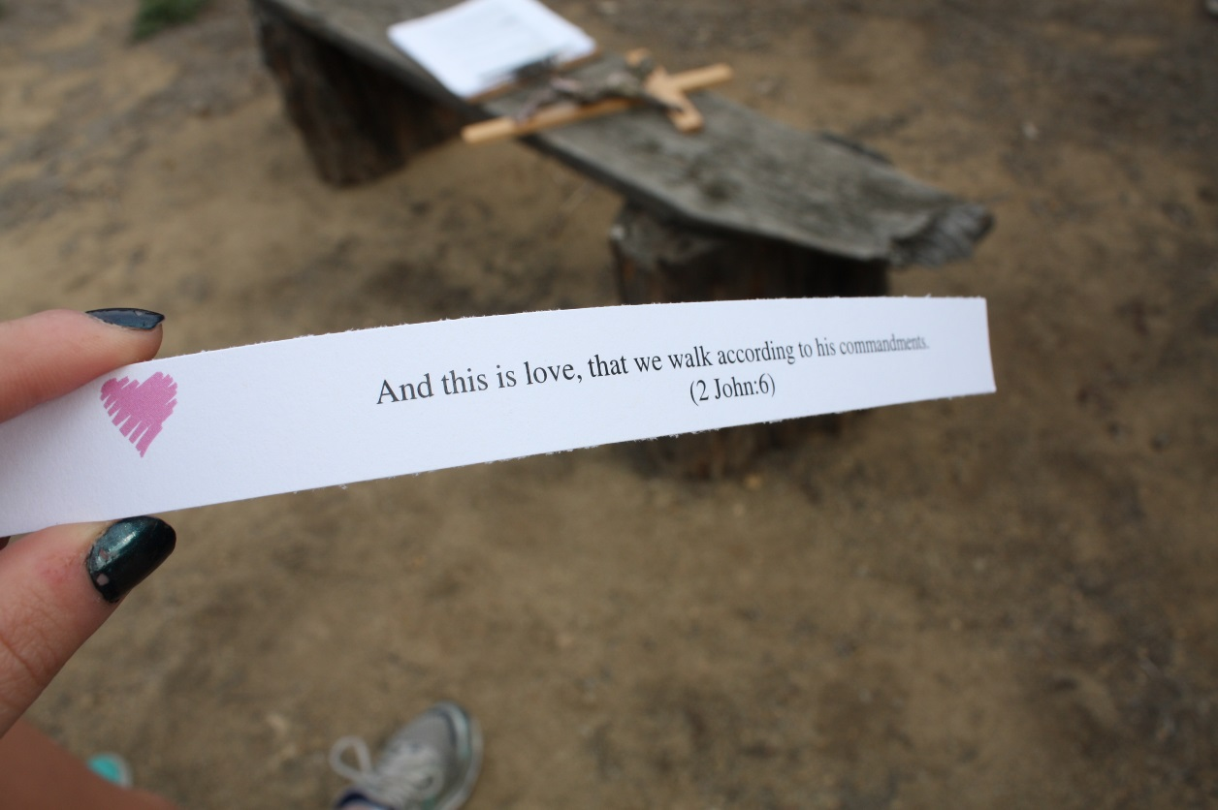
Prepare Silence Instructions
As when planning a session, be sure of your focus, theme, and goal. Envision the prayer, feel the flow, get a sense of space, time, sound, silence, and so on. Select Readers and assign roles ahead of time. If possible, rehearse with those chosen to read.
Our lives are noisy already. Much of our prayer is too wordy. Allow for periods of silence. Be sure to include silence during the prayer service, perhaps after a prayer or a reading.
There’s nothing worse than interrupting a prayer to give directions such as “the left side takes this part, and the right side takes that part!”

Slide 71
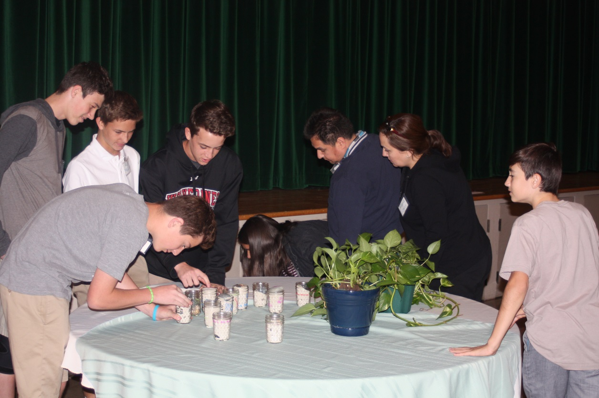
Creative spontaneous proclaim
Consider using appropriate visuals (video, DVD, slides, PowerPoint, and so on).
Not everyone is comfortable with spontaneous prayer, but it is a form of prayer that needs to be taught and fostered.
Throughout the prayer service speak clearly and slowly. Proclamation is more than merely reading the text and less than a dramatic performance. As you speak, try not to bury your head in the text; look at the assembly as much as possible. Speaking in this way will help to involve the participants.

Slide 72
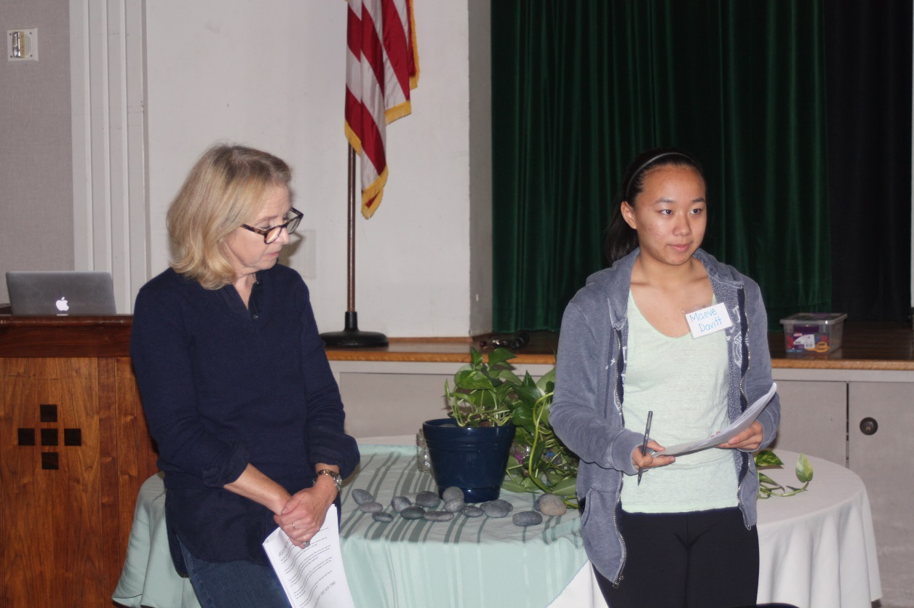
Move with Reverence
Moving with reverence means moving not too quickly or slowly, and not stiffly, but with ease and regard for what you are doing.
By following these simple suggestions, you can involve yourself effectively and wholeheartedly in a prayer service so that others will follow.
https://www.loyolapress.com/our-catholic-faith/parish-ministry/leading-prayer/leading-a-prayer-service-part-1

Slide 73
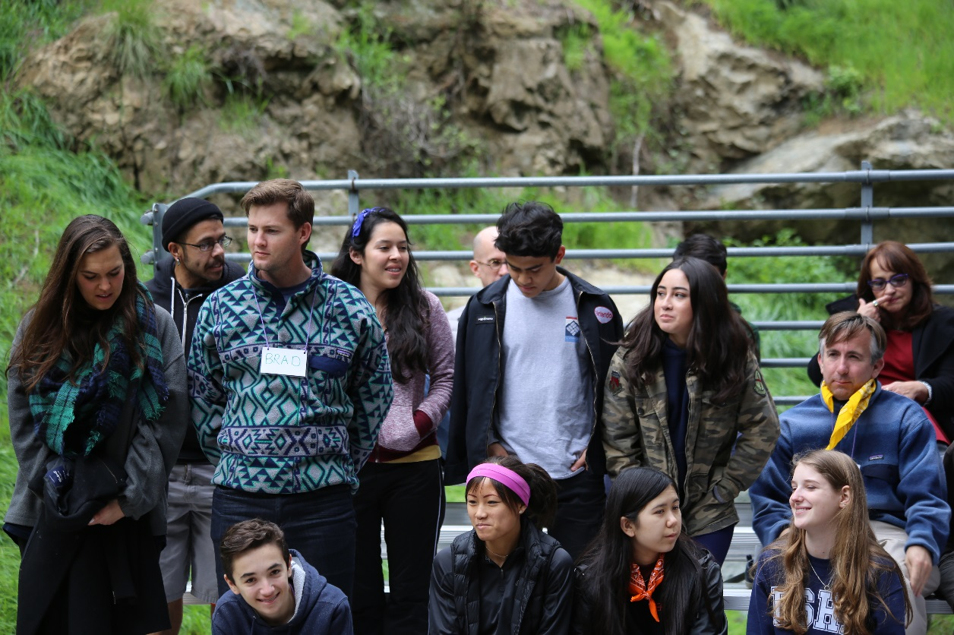
By following these simple suggestions, you can involve yourself effectively and wholeheartedly in a prayer service so that others will follow.
https://www.loyolapress.com/our-catholic-faith/parish-ministry/leading-prayer/leading-a-prayer-service-part-1

Slide 74
Working together
Gather
Listen
Respond
Send Forth
Notes:
Invite each group of seven to work on a gathered prayer.
One group will prepare a grace prayer to use before me leave for lunch today
One group will prepare a prayer to use when we gather for our second workshop right after lunch
One group will prepare our closing prayer

